Slide 1
Risk-averse preferences as an AGI safety technique
Carl Shulman, Singularity Institute
Anna Salamon, Singularity Institute

Slide 2
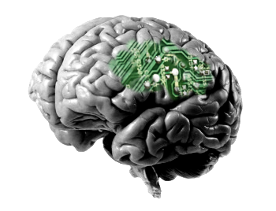
Baby AGI in a Box

Slide 3
Baby AGI in a Box
attempt escape

Slide 4
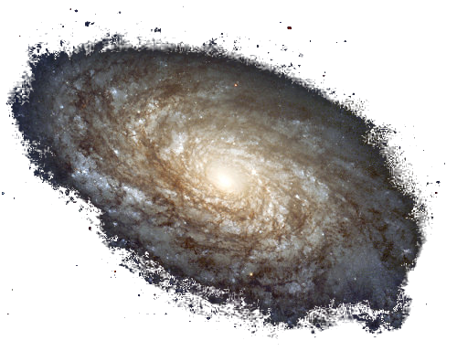
Baby AGI in a Box
take over universe
80% chance
attempt escape

Slide 5
Baby AGI in a Box
take over universe
80% chance
attempt escape
20% chance
shutdown

Slide 6
Baby AGI in a Box
take over universe
80% chance
attempt escape
20% chance
shutdown
cooperate

Slide 7
Baby AGI in a Box
take over universe
80% chance
attempt escape
20% chance
shutdown
cooperate
reward

Slide 8
U_{conquest} > U_{reward}

Slide 9
But…
P(reward) > P(conquest)

Slide 10
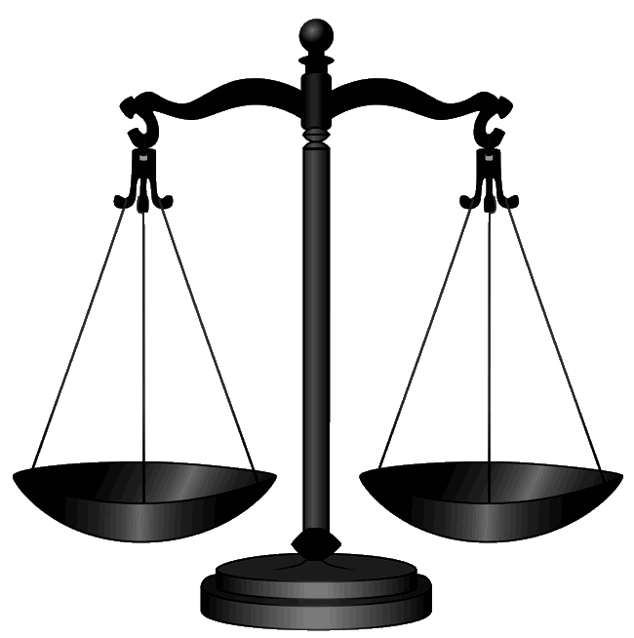
Attempt escape if:
P(conq.)U_{conq.} + P(shutdown)U_{shutdown}
>
P(reward)U_{reward}

Slide 11
Is this a plausible scenario?

Slide 12
Why utility functions?

Slide 13
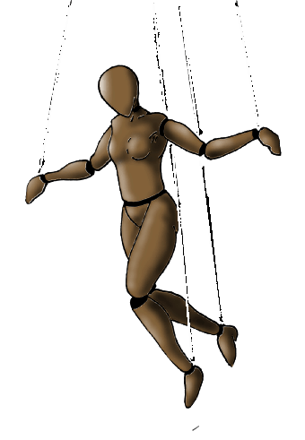
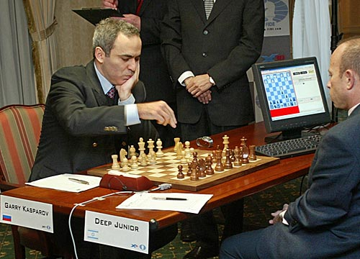
Optimizers are useful
hand-specified actions
domain-specific optimizer (e.g., chess AI)
optimizer

Slide 14
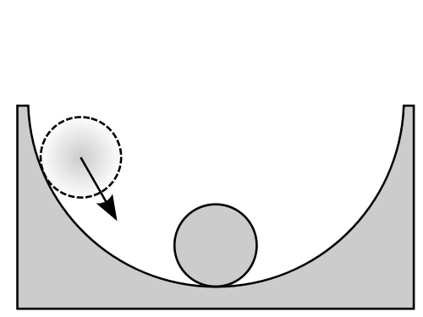
“Optimize for X” is an attractor
(Omohundro, 2008)

Slide 15
Why alien goals?

Slide 16
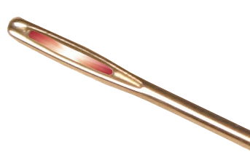
Hard to design the right optimization-target

Slide 17
So, scenarios with AGIs with alien goals worth considering
attempt escape
cooperate

Slide 18
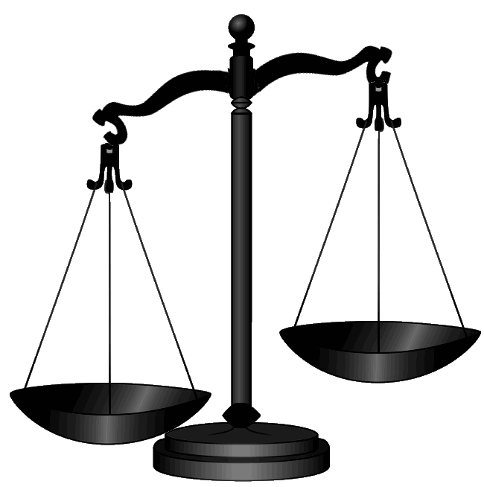
Is anyone really this risk-averse?

Slide 19
Baby AGI in a Box
take over universe
80% chance
attempt escape
20% chance
shutdown
cooperate
reward

Slide 20
Risk-averse preferences are common

Slide 21
Would you rather have
10% chance of 10^100 years of superhuman existence
Certainty of happy lifetime in modern USA
Posner 2004

Slide 22
Would you rather have
10⁻²⁰ chance of 10^100 years of superhuman existence
Certainty of happy lifetime in modern USA

Slide 23
U(universe)=number of copies of genome X, up to n

Slide 24
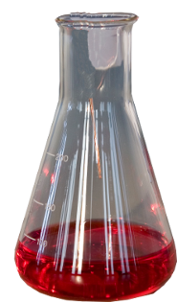
Small ceiling, n
10% chance of entire universe
certainty of
1 trillionth of universe

Slide 25
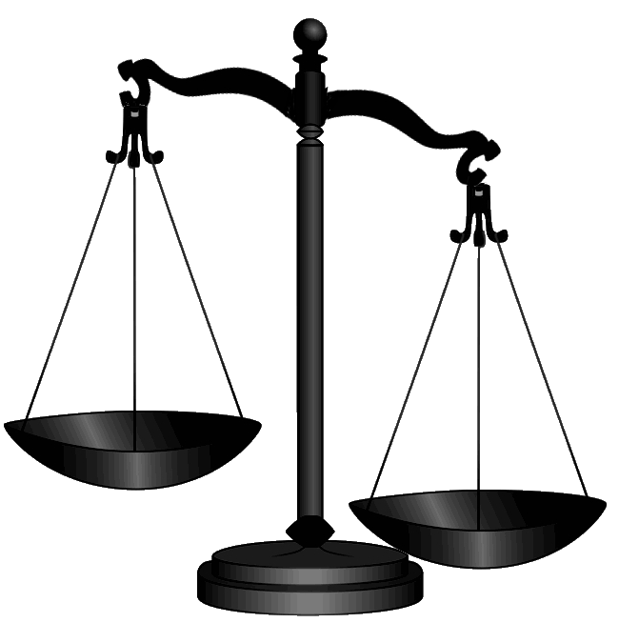
Universe-sized ceiling
Utility linear in resources
certainty of
1 trillionth of universe
10% chance of entire universe

Slide 26
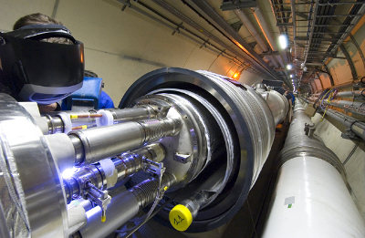
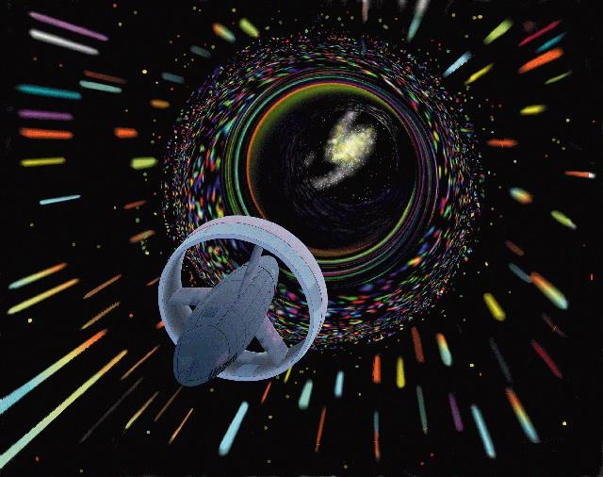
Much higher ceiling

Slide 27
Much higher ceiling
10⁻²⁰ * 10²⁰⁰ > 10⁶⁰
probability of strange physics permitting vast resources
payoff if so
normal payoff

Slide 28
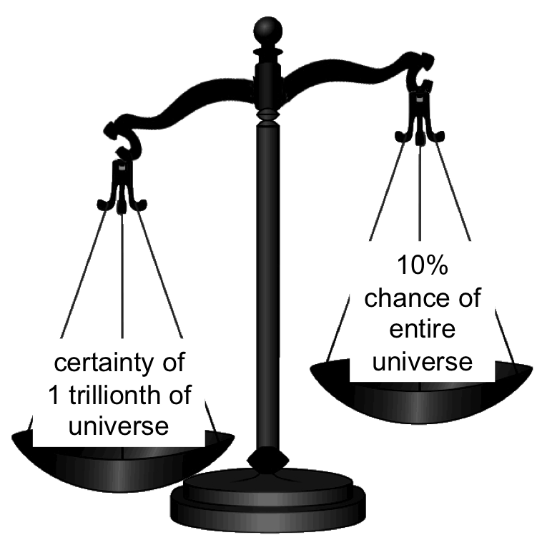
Much higher ceiling
?
10⁻²⁰ * 10²⁰⁰ > 10⁶⁰
probability of strange physics permitting vast resources
payoff if so
normal payoff

Slide 29
“Most” ceilings cause risk-averse preferences
n=1
10
10⁶
10²⁰
10⁶⁰
10¹⁰⁰
10¹⁰⁰⁰
already hit ceiling
small n
universe-sized n
much higher ceiling

Slide 30
Who cares?

Slide 31
Gains from trade

Slide 32
Gains from trade

Slide 33
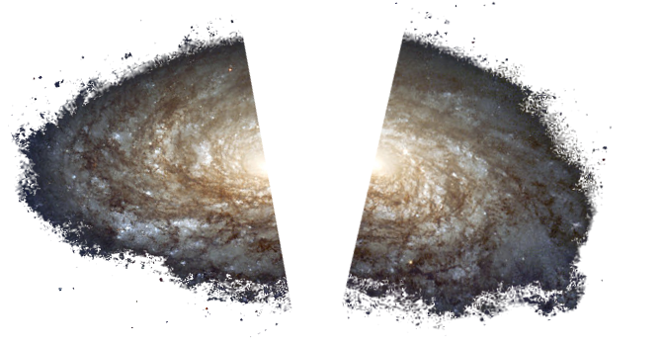
Gains from trade

Slide 34
Gains from trade
10% chance of 10^100 years of superhuman existence
Certainty of happy lifetime in modern USA
Posner 2004

Slide 35
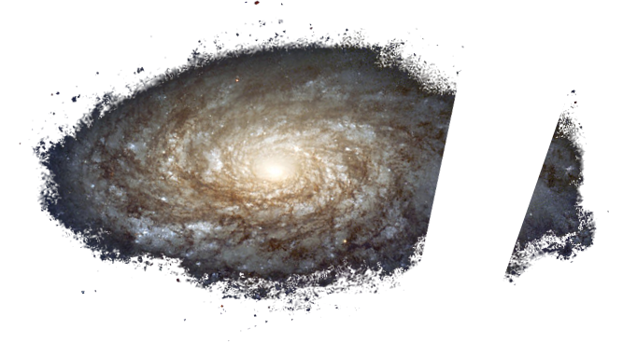
Gains from trade with AIs?

Slide 36
Baby AGI in a Box
take over universe
80% chance
attempt escape
20% chance
shutdown
cooperate
reward

Slide 37
If approaches like this can reduce risk …

Slide 38
An extra roll of the dice

Slide 39
Could be used to bootstrap toward safe, powerful AGI

Slide 41
Limitations

Slide 42
Limitation 1: Human promise-keeping

Slide 43
attempt escape
cooperate
reward

Slide 44
Requires human promise-keeping
attempt escape
cooperate
95% chance
reward
5% chance
shutdown

Slide 45
Requires human promise-keeping
attempt escape
cooperate
95% chance
reward
5% chance
shutdown
Chosen
reneging

Slide 46
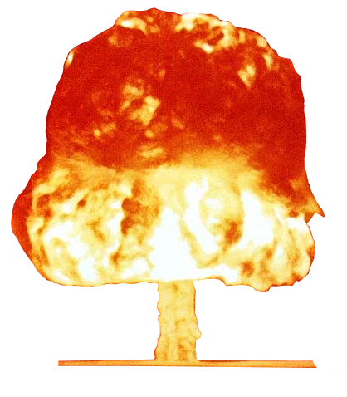
Requires human promise-keeping
attempt escape
cooperate
95% chance
reward
5% chance
shutdown

Slide 47
Attempt escape if:
P(conq.)U_{conq.} + P(shutdown)U_{shutdown}
>
P(reward)U_{reward}

Slide 48
Smaller promises more trustworthy

Slide 49
Which parts accessible to trade?
n=1
10
10⁶
10²⁰
10⁶⁰
10¹⁰⁰
10¹⁰⁰⁰
already hit ceiling
small n
universe-sized n
much higher ceiling

Slide 50
Limitation 2: AGI power range

Slide 51
0 ≠ P(escape) < P(reward)

Slide 52
Works only for a narrow range of powers
humans automatically win
gains from trade
AGI automatically wins

Slide 53
Works only for a narrow range of powers
humans automatically win
gains from trade
AGI automatically wins

Slide 54
Works only for a narrow range of powers
0 ≠ P(escape) < P(reward)
humans automatically win
gains from trade
AGI automatically wins

Slide 55
Works only for a narrow range of powers
P(escape)> P(reward)
humans automatically win
gains from trade
AGI automatically wins

Slide 56
Works only for a narrow range of powers
humans automatically win
gains from trade
AGI automatically wins

Slide 57
Extensions

Slide 58
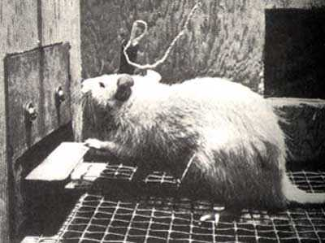
High temporal discounting also worth considering

Slide 59
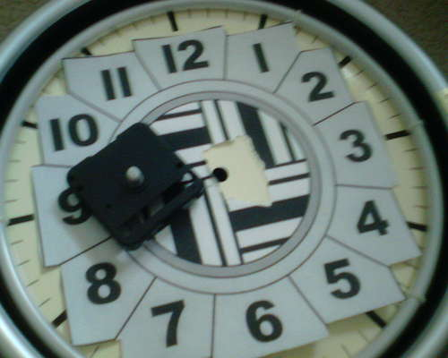
High temporal discounting also worth considering

Slide 60
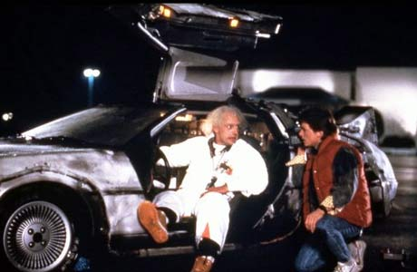
High temporal discounting also worth considering

Slide 61
Results can generalize
attempt escape
cooperate

Slide 62
Thus, investigate:

Slide 63
Thus, investigate:
Resource-satiable AGI designs

Slide 64
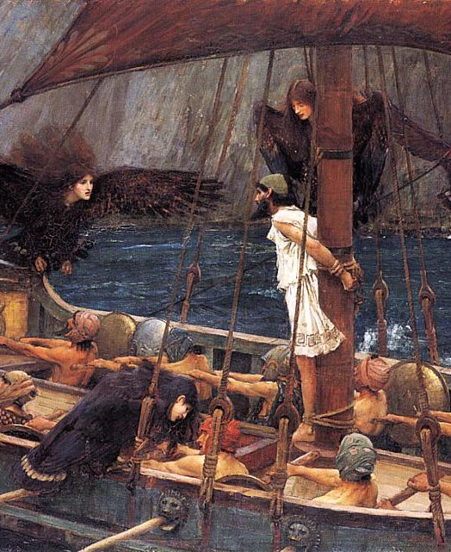
Thus, investigate:
Human norms and precommitments

Slide 65
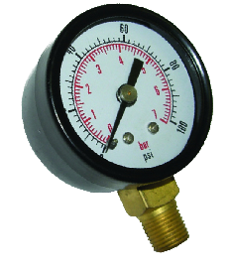
Thus, investigate:
Ways to slowly turn up the power

Slide 67
Thank you
Carl Shulman
carl.shulman@post.harvard.edu
Anna Salamon
annasalamon.com
anna@singinst.org
singinst.org/upload/ai-resource-drives.pdf

Slide 68
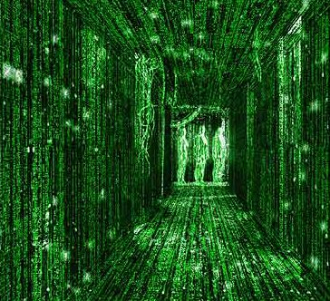
“Already hit” ceiling

Slide 69
“Already hit” ceiling
99.9999%:
The Universe is what it seems

Slide 70
“Already hit” ceiling
99.9999%:
The Universe is what it seems
U = max; actions make no difference

Slide 71
“Already hit” ceiling
99.9999%:
The Universe is what it seems
U = max; actions make no difference
0.0001% chance the universe is an illusion

Slide 72
“Already hit” ceiling
99.9999%:
The Universe is what it seems
U = max; actions make no difference
0.0001% chance the universe is an illusion
Actions make a difference

Slide 73
“Already hit” ceiling
99.9999%:
The Universe is what it seems
U = max; actions make no difference
0.0001% chance the universe is an illusion
Actions make a difference

Slide 74
“Already hit” ceiling
?
99.9999%:
The Universe is what it seems
U = max; actions make no difference
0.0001% chance the universe is an illusion
Actions make a difference

